Slide 1
BHP Billiton Ltd
Sept 2015
Overview

Slide 2
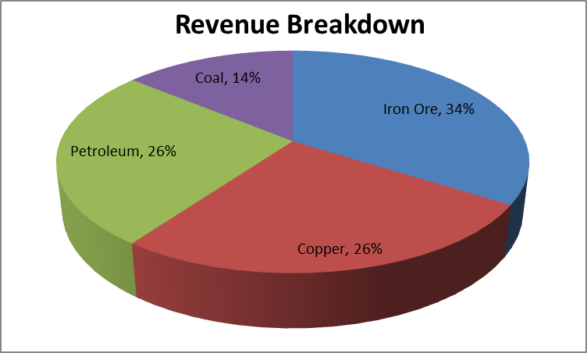
BHP Billiton Ltd
BHP is the largest resource company in the world
Primarily involved in the extraction of essential resources such as Iron Ore, Coal, Copper and more recently Petroleum
BHP has a diversified business model that is less exposed
to any one commodity relative to peers (see chart)
BHP is the lowest cost producer in most of the business
that they operate in, leading to highest margins in the business
Management has clear understanding of the cyclical business and the historically inexorable path that enables extraction at a lower price. CEO Andrew Mackenzie said, “Cycles are part of our industry. “We have to get better in the way we operate” rather than rely on markets improving
BHP has a commitment to growing its dividend which is currently 6% and is able to well cover this distribution with its cash earnings even in a low commodity price environment
Very strong balance sheet with little debt, strong financial metrics and plenty of financial flexibility
Source: bhpbilliton.com

Slide 3
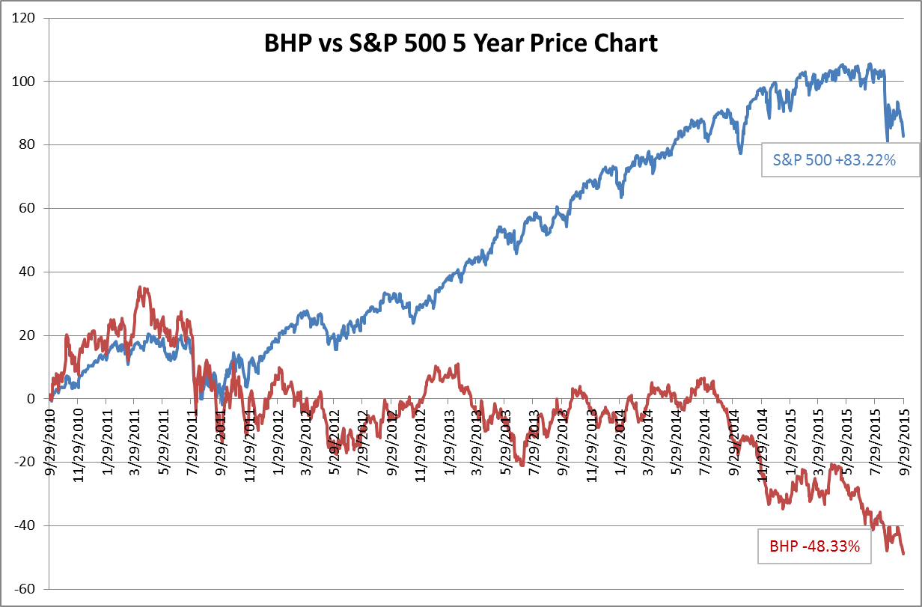
BHP Relative Value
Source: Bloomberg
Source: Bloomberg

Slide 4
Disclaimer
This document is confidential and may not be reproduced or redistributed without the prior written consent of New Vernon Wealth Management LLC (NV-WM).
Neither the information nor any opinion expressed in this document constitutes an offer by NV-WM to buy or sell any securities or financial instruments, or to provide any personalized investment advice or service. The services, securities and financial instruments described in this document may not be suitable for you, and not all strategies are appropriate at all times. Opinions expressed are only our current opinions or our opinions on the posted date. The opinions expressed in this document do not involve the rendering of personalized investment advice, and are limited to the dissemination of information on sectors, industries, markets, companies, products and services. Any security noted in the presentation is not, and should not be construed as a recommendation or rating for the reader to buy, sell, or hold the security.
Past performance is not a guarantee or a reliable indicator of future results. All investments contain risk and may lose value. Therefore, no current or prospective client should assume that future performance of any specific investment, investment strategy or product made reference to directly or indirectly, will be profitable or equal past performance. Different types of investments involve varying degrees of risk, and there can be no assurances that any specific investment will either be suitable or profitable for a particular client’s investment portfolio. Investors should consult their investment professional prior to making any investment decision based on the information provided herein.
This material contains the opinions of NV-WM and such opinions are subject to change without notice. This material has been distributed for informational purposes only and should not be considered as personalized investment advice or a recommendation of any particular security, strategy or investment product. Information contained herein has been obtained from sources believed to be reliable, but cannot be guaranteed.

